Slide 1

Madhan Raj. V
710022243027
Shivaprakash. S 710022243037
Thillainatarajan. B
710022243034
Rohith .R
710022243010
MONEY MATTERS: A PERSONAL FINANCE MANAGEMENT APP

Slide 2
PROJECT DESCRIPTION
Introduction :
The Expenses Tracker is an Android app that helps users manage their daily expenses by letting them record purchases, set a spending limit, and view their spending history. With a clean, easy-to-use interface, users can quickly add new expenses and see if they’re close to exceeding their budget.
Key Features:
Add New Expense: Users can enter details like item name, quantity, and cost. Once added, the app calculates the remaining budget and warns if the expense limit is exceeded.
Set Spending Limit: Users can define a spending limit to help control their budget. The app alerts users if they go over this limit.
View Expense History: The app provides a history of all past expenses, allowing users to track their spending patterns.
Technical Details:
Tech Stack: Android with Jetpack Compose, SQLite for local data storage, and Material Design components.
Database: SQLite for persisting expense records and spending limits through ItemsDatabaseHelper and ExpenseDatabaseHelper.
UI/UX: The app has a user-friendly interface, including a prominent "Add Expense" screen with a colorful and modern layout, utilizing Jetpack Compose's MaterialTheme and custom components.

Slide 3
Main Activity.kt:
package com.example.expensestracker
import android.annotation.SuppressLint
import android.content.Intent
import android.os.Bundle
import androidx.activity.ComponentActivity
import androidx.activity.compose.setContent
import androidx.compose.foundation.background
import androidx.compose.foundation.clickable
import androidx.compose.foundation.layout.*
import androidx.compose.foundation.shape.RoundedCornerShape
import androidx.compose.material.*
import androidx.compose.runtime.*
import androidx.compose.ui.Alignment
import androidx.compose.ui.Modifier
import androidx.compose.ui.draw.clip
import androidx.compose.ui.graphics.Color
import androidx.compose.ui.text.font.FontWeight
import androidx.compose.ui.text.style.TextAlign
import androidx.compose.ui.unit.dp
import androidx.compose.ui.unit.sp
import com.example.expensestracker.ui.theme.ExpensesTrackerTheme
import java.text.SimpleDateFormat
import java.util.*

Slide 4
class MainActivity : ComponentActivity() {
private lateinit var expenseDatabaseHelper: ExpenseDatabaseHelper
private lateinit var itemsDatabaseHelper: ItemsDatabaseHelper
@SuppressLint("UnusedMaterialScaffoldPaddingParameter")
override fun onCreate(savedInstanceState: Bundle?) {
super.onCreate(savedInstanceState)
expenseDatabaseHelper = ExpenseDatabaseHelper(this)
itemsDatabaseHelper = ItemsDatabaseHelper(this)
setContent {
ExpensesTrackerTheme {
Surface(
modifier = Modifier.fillMaxSize(),
color = MaterialTheme.colors.background
) {
DashboardScreen(
onAddExpenseClick = { startActivity(Intent(applicationContext, AddExpensesActivity::class.java)) },
onSetLimitClick = { startActivity(Intent(applicationContext, SetLimitActivity::class.java)) },
onViewRecordsClick = { startActivity(Intent(applicationContext, ViewRecordsActivity::class.java)) },
expenseDatabaseHelper = expenseDatabaseHelper,
itemsDatabaseHelper = itemsDatabaseHelper
)
}
}
}}

Slide 5
@Composable
fun DashboardScreen(
onAddExpenseClick: () -> Unit,
onSetLimitClick: () -> Unit,
onViewRecordsClick: () -> Unit,
expenseDatabaseHelper: ExpenseDatabaseHelper,
itemsDatabaseHelper: ItemsDatabaseHelper
) {
Column(
modifier = Modifier
.fillMaxSize()
.background(Color(0xFFF5F5F5))
.padding(16.dp)
) {
DashboardHeader()
Spacer(modifier = Modifier.height(24.dp))
QuickStats(expenseDatabaseHelper)
Spacer(modifier = Modifier.height(24.dp))
ActionCards(
onAddExpenseClick = onAddExpenseClick,
onSetLimitClick = onSetLimitClick,
onViewRecordsClick = onViewRecordsClick)
Spacer(modifier = Modifier.height(24.dp))
RecentTransactions(itemsDatabaseHelper)
}
}

Slide 6
@Composable
fun DashboardHeader() {
val currentDate = remember {
SimpleDateFormat("EEEE, dd MMM yyyy", Locale.getDefault()).format(Date())
}
Column {
Text(
text = "Expense Dashboard",
fontSize = 28.sp,
fontWeight = FontWeight.Bold,
color = Color(0xFF2C3E50)
)
Text(
text = currentDate,
fontSize = 14.sp,
color = Color.Gray
)
}
}

Slide 7
@Composable
fun QuickStats(expenseDatabaseHelper: ExpenseDatabaseHelper) {
val remainingAmount = remember {
expenseDatabaseHelper.getExpenseAmount(1) ?: 0
}
Card(
modifier = Modifier
.fillMaxWidth()
.height(100.dp),
elevation = 4.dp,
backgroundColor = Color(0xFF3498DB)
) {
Column(
modifier = Modifier
.padding(16.dp)
.fillMaxSize(),
verticalArrangement = Arrangement.Center
) {
Text(
text = "Available Balance",
color = Color.White,
fontSize = 16.sp
)

Slide 8
Text(
text = "₹ $remainingAmount",
color = Color.White,
fontSize = 32.sp,
fontWeight = FontWeight.Bold
)
}
}
}
@Composable
fun ActionCard(
title: String,
backgroundColor: Color,
onClick: () -> Unit,
modifier: Modifier = Modifier
) {
Card(
modifier = modifier
.height(100.dp)
.clickable(onClick = onClick),
elevation = 4.dp,
backgroundColor = backgroundColor
) {

Slide 9
Box(
modifier = Modifier
.fillMaxSize()
.padding(8.dp),
contentAlignment = Alignment.Center
) {
Text(
text = title,
color = Color.White,
fontSize = 16.sp,
fontWeight = FontWeight.Bold,
textAlign = TextAlign.Center
)
}
}
}
@Composable
fun RecentTransactions(itemsDatabaseHelper: ItemsDatabaseHelper) {
val recentItems = remember {
itemsDatabaseHelper.getAllItems().takeLast(3)
}

Slide 10
Column {
Text(
text = "Recent Transactions",
fontSize = 20.sp,
fontWeight = FontWeight.Bold,
color = Color(0xFF2C3E50),
modifier = Modifier.padding(bottom = 16.dp)
)
recentItems.forEach { item ->
TransactionItem(item)
Spacer(modifier = Modifier.height(8.dp))
}
}
}
@Composable
fun TransactionItem(item: Items) {
Card(
modifier = Modifier
.fillMaxWidth()
.height(70.dp),
elevation = 2.dp
) {

Slide 11
Row(
modifier = Modifier
.fillMaxSize()
.padding(horizontal = 16.dp),
horizontalArrangement = Arrangement.SpaceBetween,
verticalAlignment = Alignment.CenterVertically
) {
Column {
Text(
text = item.itemName ?: "",
fontSize = 16.sp,
fontWeight = FontWeight.Medium
)
Text(
text = "Qty: ${item.quantity}",
fontSize = 14.sp,
color = Color.Gray)
}
Text(
text = "₹ ${item.cost}",
fontSize = 18.sp,
fontWeight = FontWeight.Bold,
color = Color(0xFFE74C3C)
)
}
}
}

Slide 12
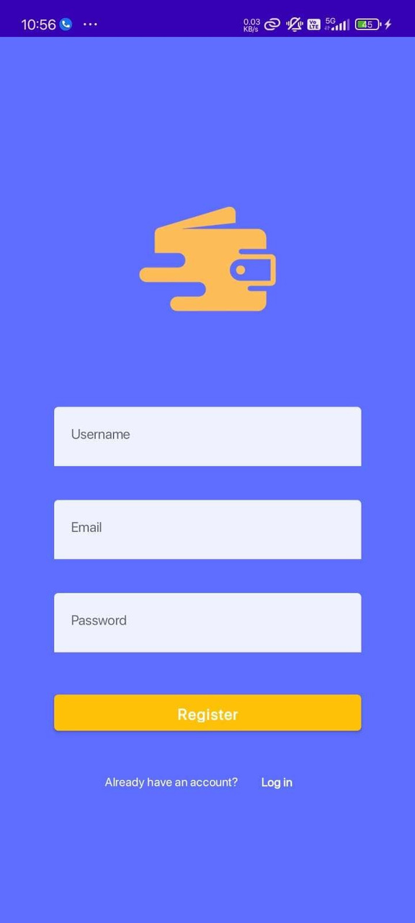
REGISTER PAGE

Slide 13
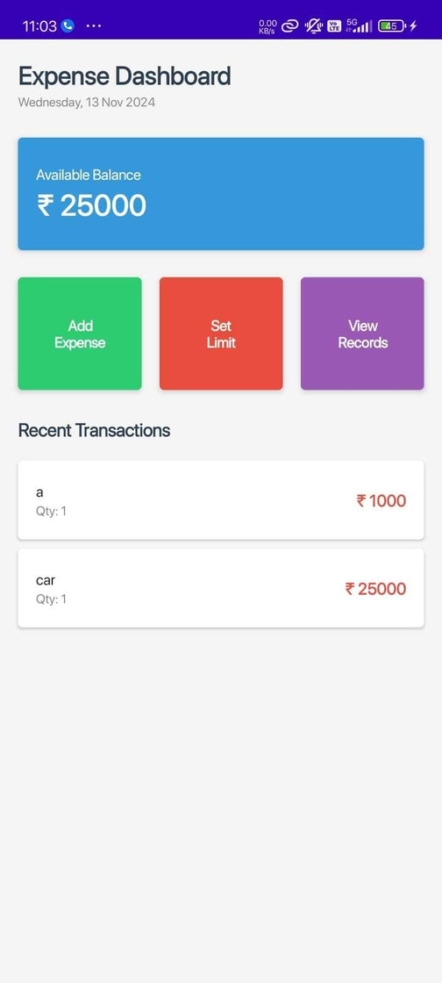
HOME SCREEN

Slide 14
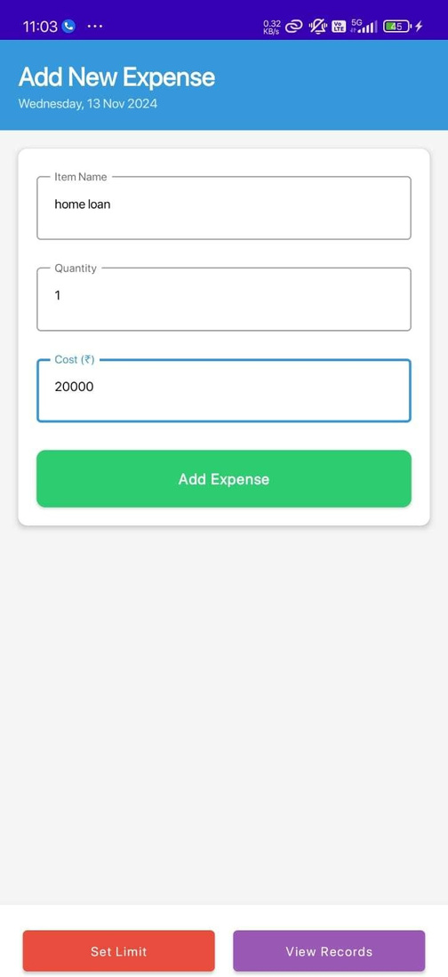
ADD ITEM EXPENSE SCREEN

Slide 15
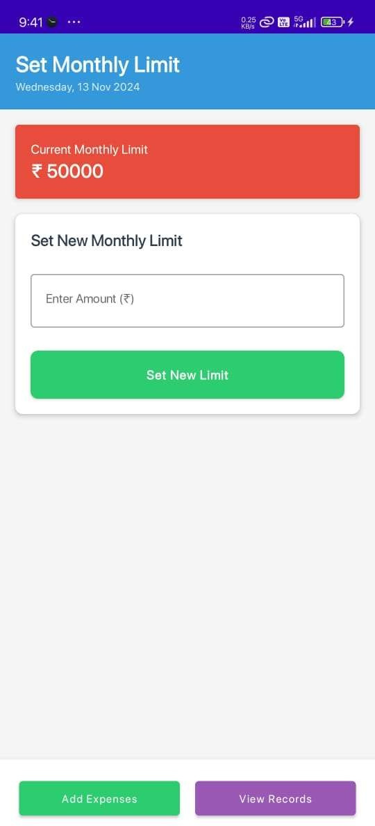
EXPENSE SUMMARY VIEW

Slide 16
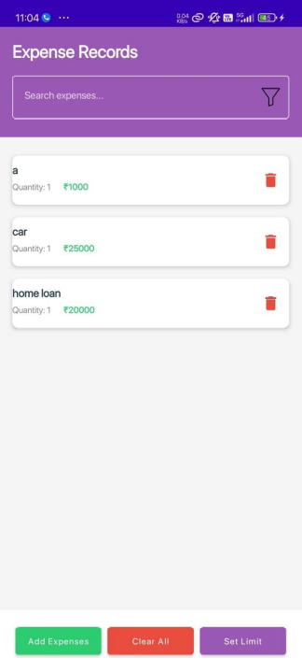
EXPENSE HISTORY VIEW

